Slide 1
Team 2:
Language as a Tool 🔧

Slide 2
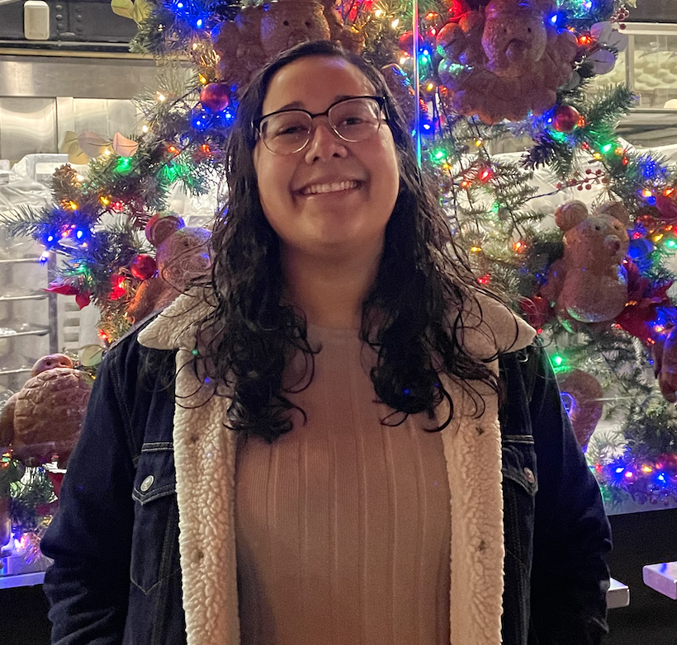
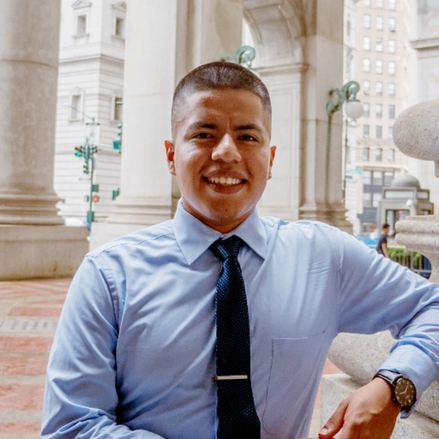
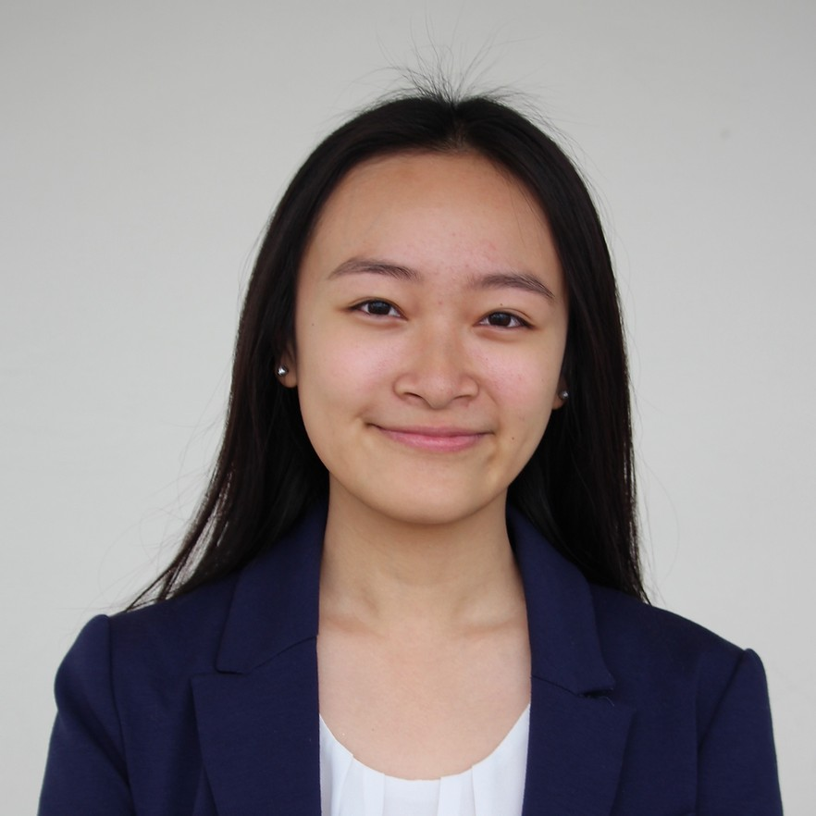
Team Members
ANNA CHANG
SELAINE RODRIGUEZ
WILMER ZUNA LARGO
AMANDA HUYNH

Slide 3
Problem Domain
Language Learning
Education and AR/VR Technology

Slide 4
Needfinding Methodology
1

Slide 5




Our Interviewees
Claudia
Stanford Chef
Early 50s
Culinary Student
Ana
Stanford Hasher
Mid 40s
Duolingo User
Tang
Professor
Early 40s
Experienced Educator
Robin*
College Student
Early 20s
Speaks 6 Languages

Slide 6
Guiding Questions
What languages do you speak / have you studied?
Tell me a little about yourself.
?
How did you learn these languages?
What factors motivated you to learn these languages?
Do you use these languages in your daily life?
How have you retained / use these languages?

Slide 7
Interview Results
2

Slide 8









Claudia

Slide 9


Ana
🧓🏽
👴🏽
🧑🏽‍🦳

Slide 10







Tang

Slide 11
Robin*
🇯🇵
🇹🇷
🇬🇧
✈️
📚
🇰🇷
㈝
🇷🇺
🎧
🇨🇳

Slide 12
Analysis
3

Slide 13
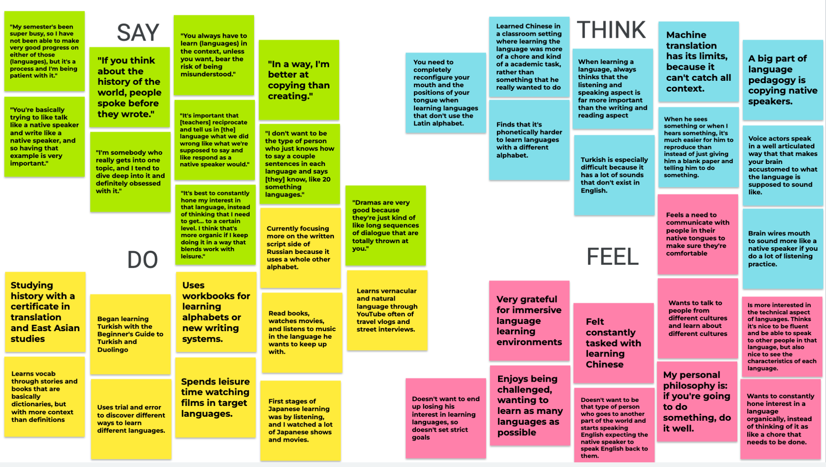
Empathy Map

Slide 14
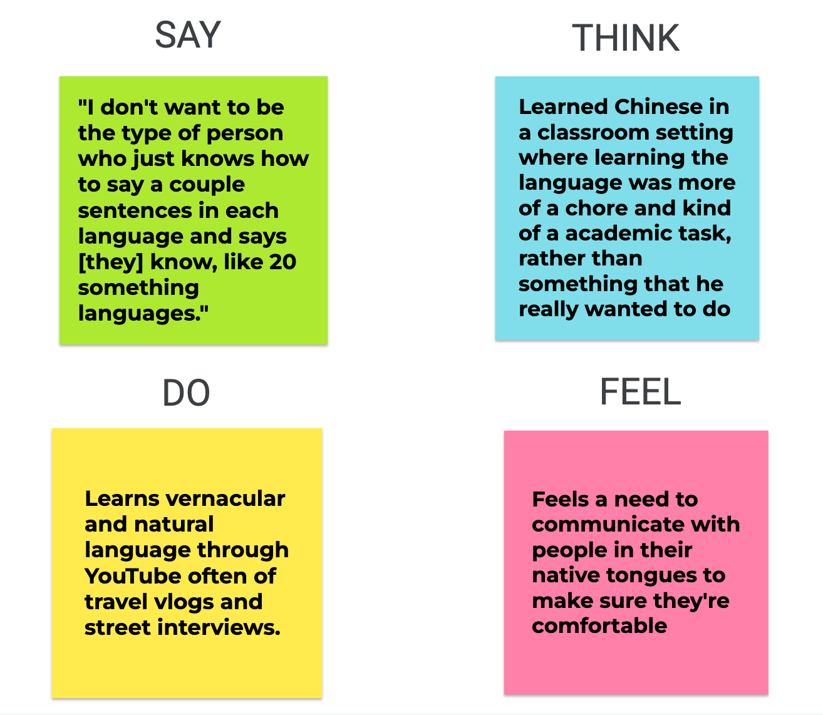

Slide 15
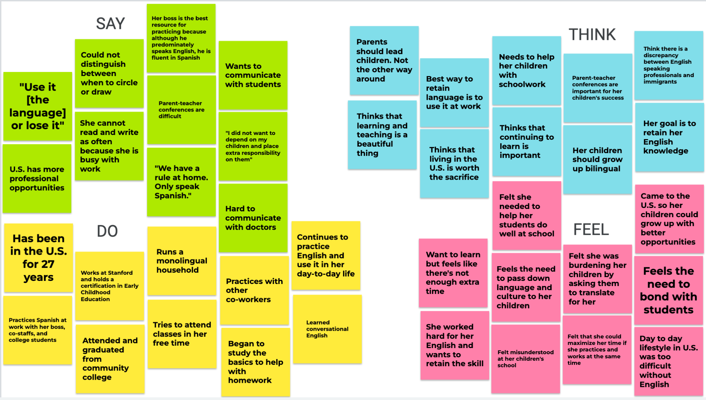

Slide 16
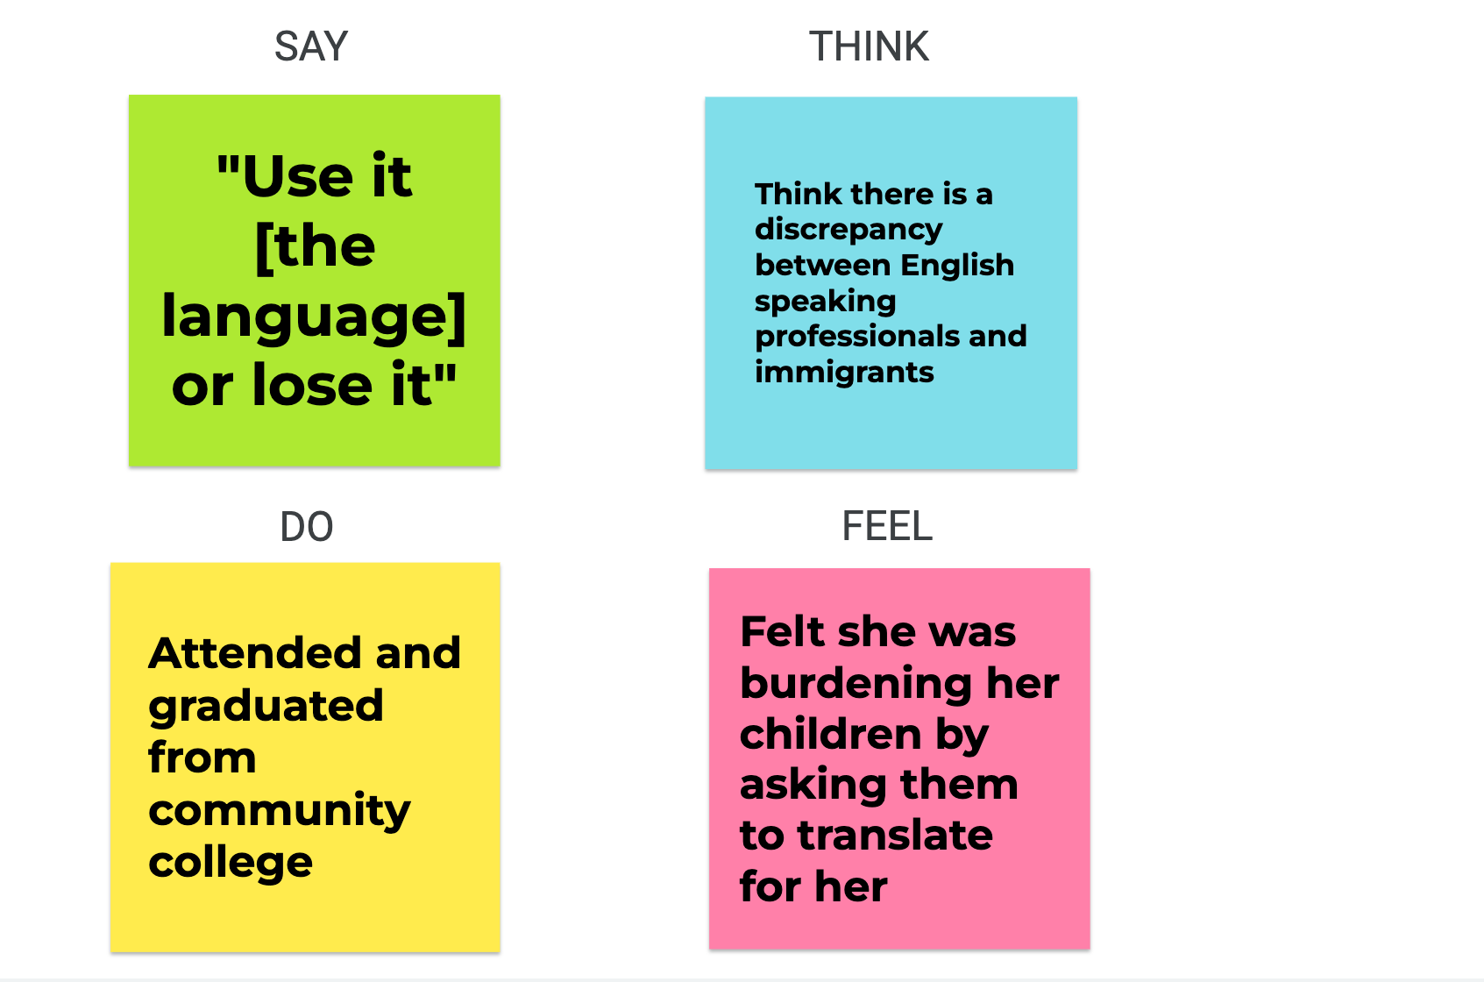

Slide 17

Sample from Claudia
“Use it or lose it.”
[Context: asking her children to translate for her]
“This is not how the dynamic should be. Parents should lead children. Not the other way around.”
Tensions: Important aspects of life were restricted due to language barrier. Over-dependent on her kids for translation.
Contradictions: Only speak Spanish at home.
Surprises: Early Childhood Education certification.

Slide 18


Sample from Ana
"I used Duolingo…daily…for 1 year… I'd say it was effective. I started to use daily words at work such as coffee, eggs, etc."
Tensions: Duolingo hasn't been effective for real conversations.
Contradictions: Her work does not require her to speak English.
Surprises: She’s been in the U.S. for 10 years but until 5 years ago, she had no interest in learning the language.

Slide 19

Sample from Tang
“I’m still trying to figure out [how to make class fun]. So far, I include something about pop culture, contemporary issues…games…and also share my own experience.”
Tensions: She didn’t enjoy learning foreign languages because of rote memorization practices.
Contradictions: She advocates for audio-lingual learning but she defaults to textbooks when self-studying.
Surprises: Her husband speaks a language she is learning but she doesn’t practice with him.

Slide 20

Sample from Robin
“I don’t want to be the type of person who just knows how to say a couple sentences in each language and say they know 20 something languages.”
Tensions: If you’re going to do something, do it well.
Contradictions: Learning in a classroom feels like a chore, an academic task.
Surprises: He doesn’t want to be the type of person who goes to another part of the world and speaks English and expect the native speaker to speak English back.

Slide 21
Insights
Needs
Current apps based learning solely on extrinsic motivation.
Individuals need intrinsic motivation to continue learning.
Most people learn languages only because they need to.
People need an efficient and practical way to learn.
People prioritize human-to-human interactions when deciding what languages to speak/learn.
Language learning should be human-centered, with an emphasis on cultural context.

Slide 22

Further Questions
Would the same results be replicated with an American sample?
How does the lack of resources about certain languages (such as indigenous languages) limit what people choose to study?
How are languages used in smaller towns and communities becoming extinct due to the dominance of their umbrella language?
How may the use of audio-lingual learning resources improve the retention of new languages?

Slide 23
Summary

Slide 24
Thanks!
Any questions ?
Slide template by SlidesCarnival

